Slide 1
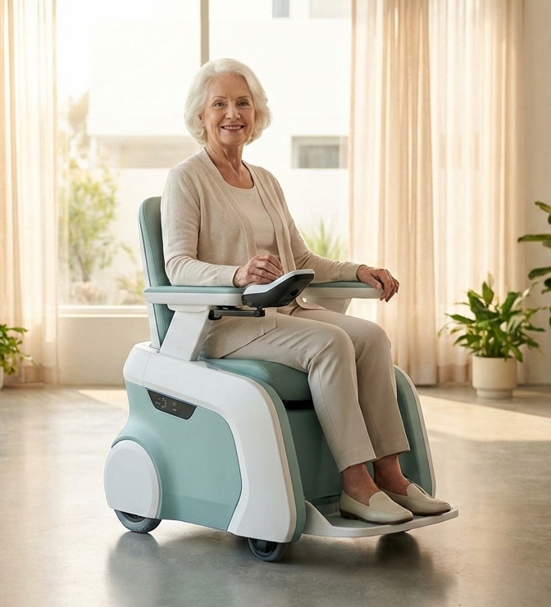
Transforming Comfy Chairs Ltd. into…
Vividly
VitalRide:
Smart Autonomous Wheelchair
Independence. Dignity. Peace of Mind.
Revolutionizing elderly mobility with AI-powered navigation, continuous health monitoring, and connected care.
Investor Presentation 2026

Slide 2
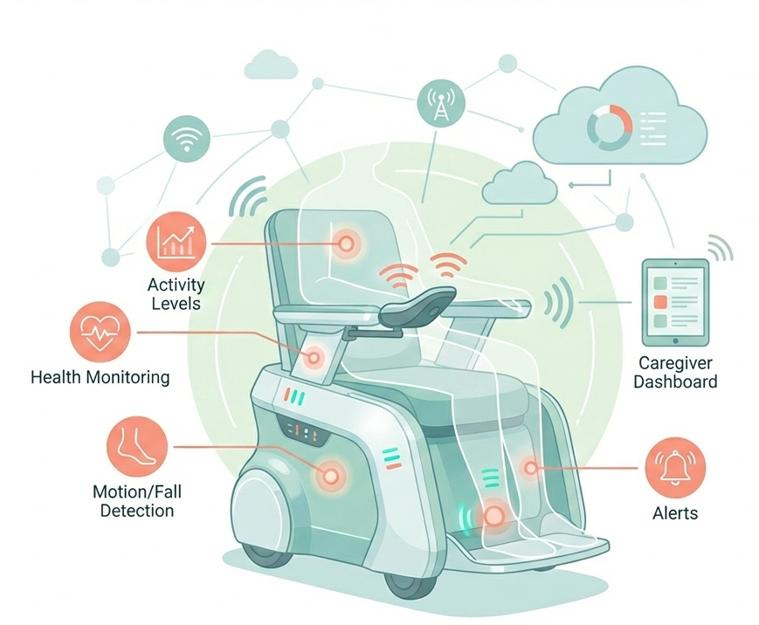
The Problem, Opportunity & Solution
THE AGING CRISIS
OUR SOLUTION
2x
65M
VitalRide
Smart wheelchairs for consumers and facilities
People 65+ will double by 2050 in Western countries
People worldwide need wheelchairs today
Autonomous Navigation
LiDAR + AI for point-to-point travel
More seniors. Fewer caregivers.
The care gap is widening every year.
Health Monitoring
Heart rate, respiratory, fall detection 24/7
Traditional wheelchairs create total dependency
Instant Safety Alerts
Health issues go undetected until emergencies
Geofencing, emergency SOS, caregiver alerts
150,000 caregiver shortage in US by 2030
Family Dashboard
Real-time monitoring and telehealth
MARKET OPPORTUNITY
$2.8B
B2B
Healthcare Facilities
B2C
Direct Consumer
Smart Chair Market by 2034
Nursing homes, rehab centers, VA hospitals,
academic medical centers, airports
Seniors aging at home, family caregivers,
disability community
Vital monitoring, fleet management
EHR integration
Full autonomous navigation,
health suite, family dashboard
Hardware: $4,500-8,000/unit | CareCloud: $99-299/month
Hardware: $5,500-9,500 | CareConnect: $29-79/month

Slide 3
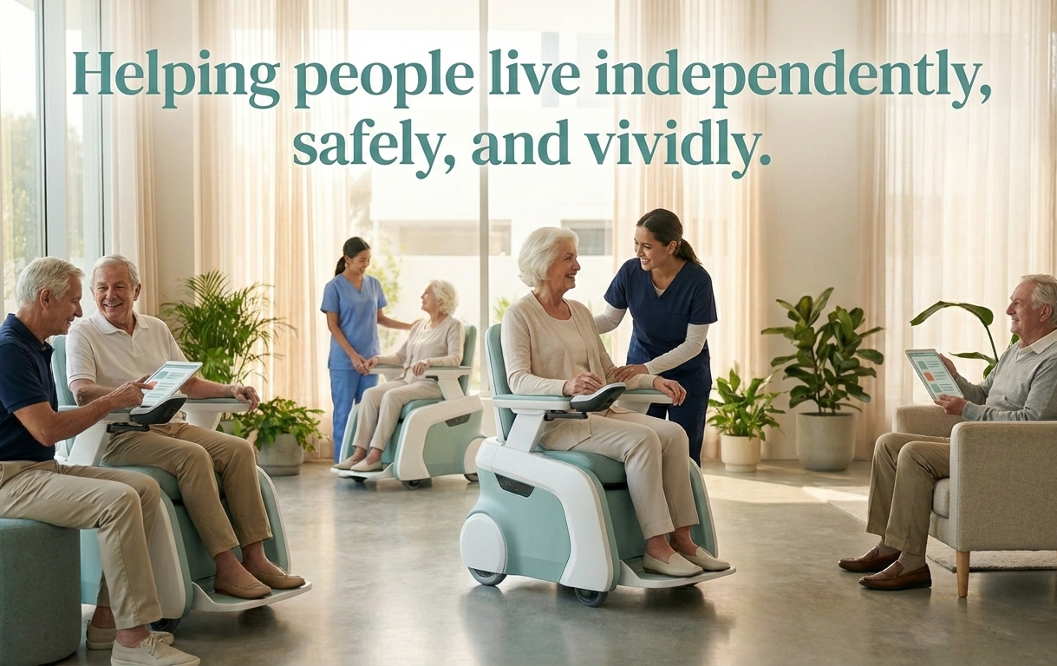
Growth Strategy
$4.5M
50-55%
10% CAGR
REVENUE PROJECTION
Series A Investment
Target Gross Margin
Market Growth Rate
Year 1
Year 2
Year 3
GO-TO-MARKET
$1.07M
$3.75M
$8.65M
150 units | $95K subscriptions
500 units | $500K subscriptions
1,100 units | $1.5M subscriptions
PHASE 1: VALIDATE (M1-12)
Pilot programs with 3-5 nursing homes and VA hospitals. Build clinical evidence and reference customers.
PHASE 2: LAUNCH (M9-18)
Consumer launch via DME dealers, e-commerce, healthcare provider referrals.
PHASE 3: SCALE (Y2-3)
Medicare reimbursement, insurance partnerships, international expansion (UK NHS, EU).
COMPETITIVE EDGE
Full Autonomy
Integrated Health
Hardware + Subscription
True point-to-point
Built-in monitoring
Revenue & upselling
Vividly
Independence. Dignity. Peace of Mind.

